Slide 1
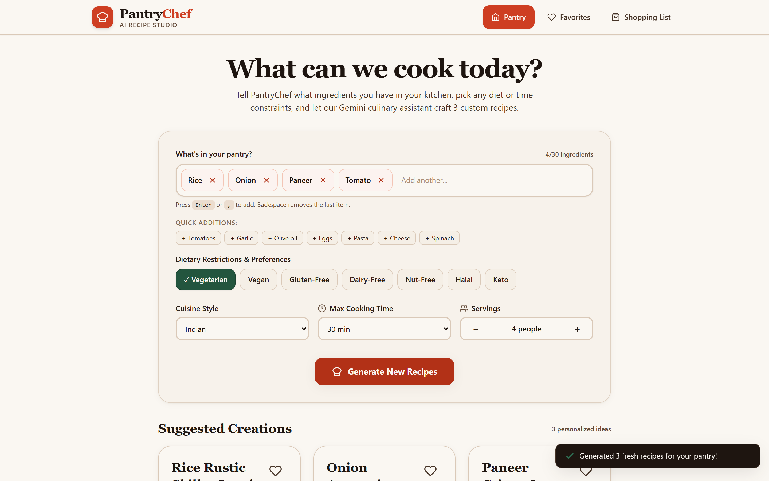
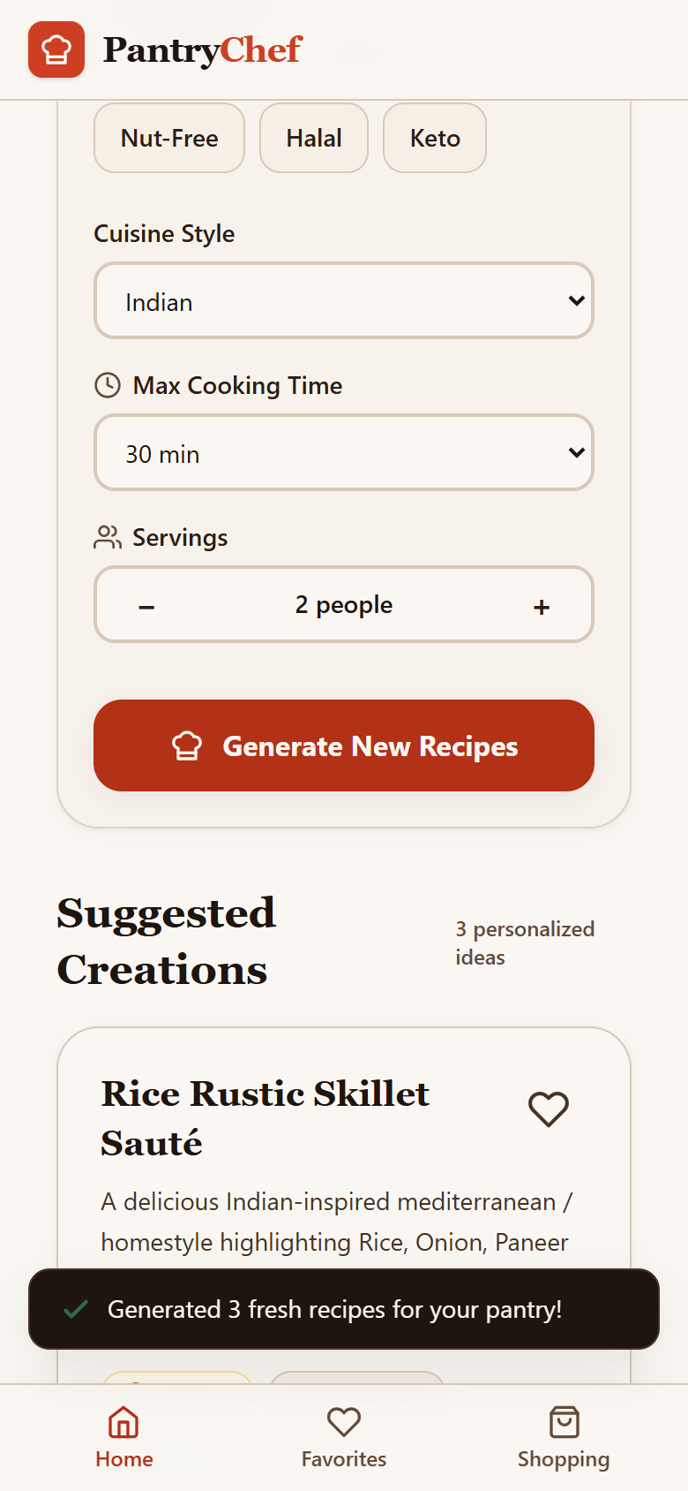
CSE279 ARTIFICIAL INTELLIGENCE PROJECT
PantryChef
Cook with what you already have
An Applied Generative AI Progressive Web App for Zero-Waste Cooking
PROJECT TEAM • SUBMITTED BY
• Deval Yadav Reg. No. 12521126
• Amil Muhammad Reg. No. 12520456
• Aakash Reg. No. 12521772
• Rupesh Kumar Reg. No. 12522091
PantryChef desktop interface (demo data)
FACULTY GUIDE: [Ayushi Bhakuni]
INSTITUTION: [Lovely Professional University
SUBMISSION: [November 2026] • Course: CSE279
Mobile PWA (emulated)

Slide 2
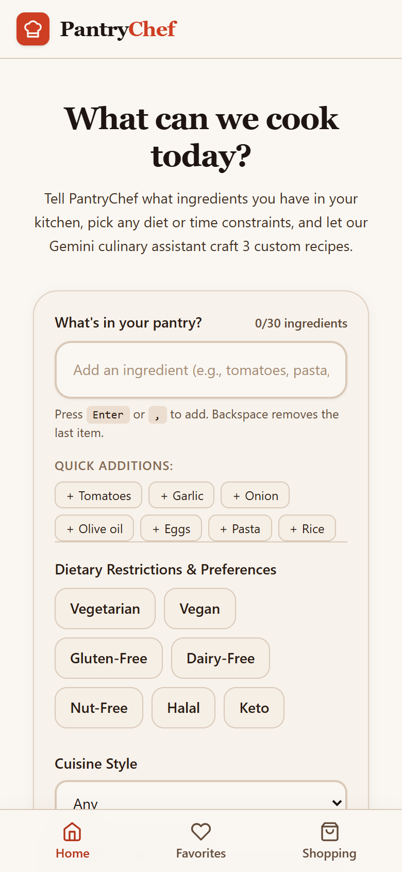
INTRODUCTION
Background & Motivation: The Everyday Kitchen Problem
Why Applied Generative AI is a Natural Fit for Zero-Waste Home Cooking
1. Forgotten Ingredients
Fresh vegetables, herbs, and staple grains frequently spoil in refrigerator crisper drawers before home cooks figure out how to combine them into appetizing meals.
2. Daily Decision Fatigue
After exhausting workdays, people face kitchen paralysis staring at odds and ends (e.g. paneer, half an onion, cooked rice), often defaulting to expensive takeout delivery.
3. Why Generative AI Fits
Traditional databases require exact recipe titles. Pre-trained LLMs excel at combinatorial reasoning—synthesizing cohesive meals from arbitrary subsets of ingredients.
Empty pantry input screen (emulated)

Slide 3
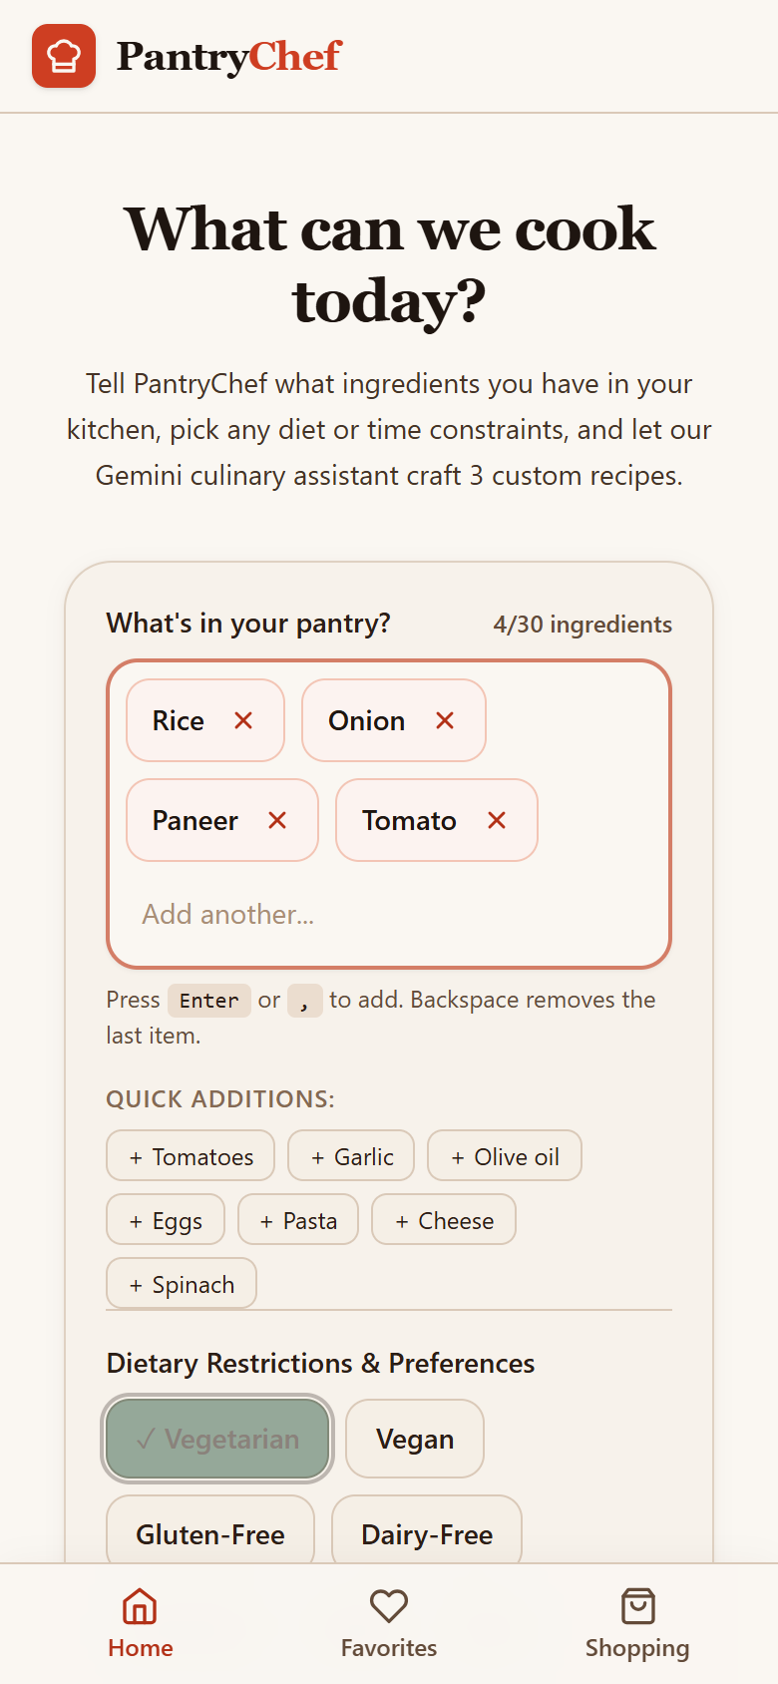
INTRODUCTION
What PantryChef Is: The Four-Step Solution
Transforming Available Ingredients into Feasts, Saved Favorites, and Shopping Checklists
1. INPUT PANTRY ITEMS
Add ingredients as keyboard chips with validation (Enter or comma).
2. SET FILTERS & PREFERENCES
Configure dietary tags (Veg/Vegan), cuisine, time limit & servings.
3. GENERATE, SAVE & SHOP
Receive 3 structured recipes; save to favorites & build grocery checklist.

Slide 4
OBJECTIVE AND SCOPE
Project Objectives: Measurable & Verifiable Goals
Concrete Benchmarks for Applied Artificial Intelligence and Full-Stack Engineering
Objective 1: Dynamic Recipe Synthesis
Generate exactly three distinct, safe culinary recipes from arbitrary user-supplied pantry ingredients and dietary restrictions using an LLM.
Objective 2: Server-Side Credential Air-Gap
Isolate the Gemini API key strictly within the backend Node.js environment, preventing credential leakage to client bundles or browser DevTools.
Objective 3: Schema Enforcement & Validation
Enforce strict JSON response schemas via the Gemini API and validate outputs at runtime using Zod, retrying automatically on malformed structures.
Objective 4: True Offline Persistence
Enable full offline retrieval of saved favorites and interactive shopping checklists using device-local IndexedDB storage.
Objective 5: Installable PWA Delivery
Package the frontend as an installable Progressive Web App with service worker asset precaching, fast mobile ergonomics, and touch responsiveness.

Slide 5
OBJECTIVE AND SCOPE
Project Scope: In Scope vs. Out of Scope
Clear Demarcation of System Capabilities for an Applied AI Capstone
IN SCOPE (DELIVERED WORK)
✓ Generative recipe synthesis using pre-trained Google Gemini via official SDK.
✓ Prompt engineering treating user text as data to neutralize prompt injection.
✓ Strict JSON structured output schema with dual-layer Zod runtime validation.
✓ Single-recipe regeneration allowing users to replace one unwanted suggestion.
✓ Express.js backend gateway with Helmet, rate limiting, and 10KB payload caps.
✓ Offline data persistence for favorites and grocery lists via device IndexedDB.
✓ PWA installability on desktop and mobile browsers with service worker caching.
OUT OF SCOPE (DELIBERATE EXCLUSIONS)
✗ Foundation model training or parameter fine-tuning (pre-trained API used).
✗ Real-time nutritional macro calculations or caloric breakdown computation.
✗ User account authentication systems or remote cloud database synchronisation.
✗ Live grocery market price scraping or supermarket inventory integration.
✗ Computer vision OCR for automated refrigerator shelf scanning (future work).
✗ Hardware kitchen appliance telemetry or IoT smart cooker connectivity.

Slide 6
GAP
Existing Approaches & Technical Gap Analysis
Evaluating Traditional Recipe Portals, Keyword Matchers, and Raw Chatbots
TYPE OF TOOL | WHAT IT DOES | TECHNICAL LIMITATION
Traditional Recipe Portals (Catalog Search) | Static relational database query filtered by recipe title or food tag. | Rigid lookup; fails completely when given unusual combinations of odds and ends; assumes full spice pantry.
Ingredient-Matching Tools (Keyword Intersection) | Computes set intersections against static recipe archives. | Requires near-100% catalog recipe match; cannot adapt to small omissions or dietary substitutions gracefully.
Generic LLM Chatbots (Raw Conversational AI) | Generates unstructured free-text recipes from conversational prompts. | Unpredictable plain text breaks application UI; leaks API keys if called client-side; offers zero offline storage.
THE PANTRYCHEF SOLUTION (BRIDGING THE GAP)
PantryChef bridges this gap by combining generative AI adaptability with strict schema enforcement, server-side API key protection, and offline device storage for saved recipes.
Academic & Industry Literature: [Add 2 to 3 real references]

Slide 7
METHODOLOGY
System Architecture & Secure Data Flow
Monorepo Architecture with Strict Server-Side AI Credential Air-Gap
CLIENT TIER
PWA Web Shell
• React 18 + TypeScript
• Tailwind CSS UI
• Vite PWA Plugin
• Service Worker Cache
OFFLINE TIER
Device Storage
• IndexedDB (idb-keyval)
• Transparent Fallback
• Persisted Favorites
• Grocery Checklist
GATEWAY TIER
Express Server
• Port 3001 Listener
• Helmet Security Headers
• CORS Allowed Origins
• Rate Limiter (100/15m)
SERVICE TIER
Recipe Generator
• Zod Dual Validation
• Prompt Data Isolation
• Error Taxonomy
• Auto-Retry Strategy
AI CLOUD TIER
Google Gemini API
• gemini-3.8-flash
• Pre-Trained LLM
• Structured Output Schema
• Culinary Guardrails
CRITICAL SECURITY ARCHITECTURE: GEMINI KEY STAYS ON SERVER
The browser never executes Gemini API calls directly. GEMINI_API_KEY is read at request time strictly from server environment variables (.env). Zero client bundle leakage, no exposure in DevTools network panels, and no secret check violations.

Slide 8
METHODOLOGY
Applied AI Approach & Prompt Architecture
Prompt Isolation, Structured JSON Schemas, Zod Validation, and Safety Guardrails
1. USER INPUTS
Raw ingredient chips, diets, time & servings constraints.
2. PROMPT BUILDER
System instructions isolate culinary role; user inputs passed strictly as data.
3. GEMINI API CALL
Pre-trained foundation model receives prompt with strict JSON schema.
4. SCHEMA VALIDATION
Runtime Zod validation checks fields (id, title, steps, haveIt tags).
5. RETRY OR ERROR
Automatic single retry on format failure; friendly error codes on API drop.
6. RECIPE CARDS
Deterministic output populated into responsive, interactive UI cards.
PROMPT DESIGN & INJECTION DEFENSE
• System Instruction: 'You are PantryChef, an expert culinary assistant and food safety specialist.'
• Data Isolation: User ingredients are sanitized and enclosed in JSON arrays, neutralizing override attempts.
• Categorization: Model explicitly sets haveIt: true for pantry items and false for missing staples.
• Clear Sequential Steps: Instructions require numbered, beginner-friendly cooking steps.
SAFETY, ALLERGENS & OUTPUT ACCURACY
• Strict Dietary Compliance: Vegetarian, Vegan, Gluten-Free filters enforced through hard system rules.
• Food Safety Guardrails: Prompt strictly forbids unsafe food advice or hazardous cooking temps.
• Dual Validation with Retry: Automatically re-queries Gemini once if JSON structure fails Zod schema.
• Allergen Disclaimer: UI explicitly alerts users to verify AI suggestions against real kitchen allergies.

Slide 9
METHODOLOGY
Implementation: Tech Stack & API Contract
Production-Grade Engineering Tooling, REST Endpoints, and Defense-in-Depth
TECHNOLOGY | ARCHITECTURAL RATIONALE
React 18 + Vite | High-speed SPA bundling, fast refresh, and native PWA plugin integration.
TypeScript 5 | Full-stack end-to-end static typing; shared schemas between server & client.
Tailwind CSS | Utility-first design tokens with high-contrast, accessible mobile tap targets.
Node 20 + Express | Lightweight backend proxy air-gapping credentials with Helmet security.
@google/genai SDK | Official Google SDK enforcing structured JSON response schemas at API level.
IndexedDB + idb-keyval | Asynchronous device storage providing zero-login offline recipe persistence.
API CONTRACT & ERROR TAXONOMY
• GET /api/health
200: { ok: true, geminiConfigured: boolean } - Never returns key.
• POST /api/recipes
200: { recipes: Recipe[3] } - 10KB body limit, max 30 ingredients.
• POST /api/recipes/regenerate
200: { recipe: Recipe } - Replaces single title without repeating.
Standardized Error Codes ({ error: { code, message } }):
[503 GEMINI_KEY_MISSING]: Key missing in server environment; app still boots.
[400 INVALID_REQUEST]: Failed Zod validation (ingredient length, serving bounds).
[429 RATE_LIMITED]: Exceeded request threshold (express-rate-limit).
[502 GEMINI_UNAVAILABLE]: Gemini service unreachable or upstream network drop.
[502 GEMINI_BAD_RESPONSE]: Model output failed schema validation after retry.
[504 TIMEOUT]: AI generation exceeded server timeout window (25s).

Slide 10
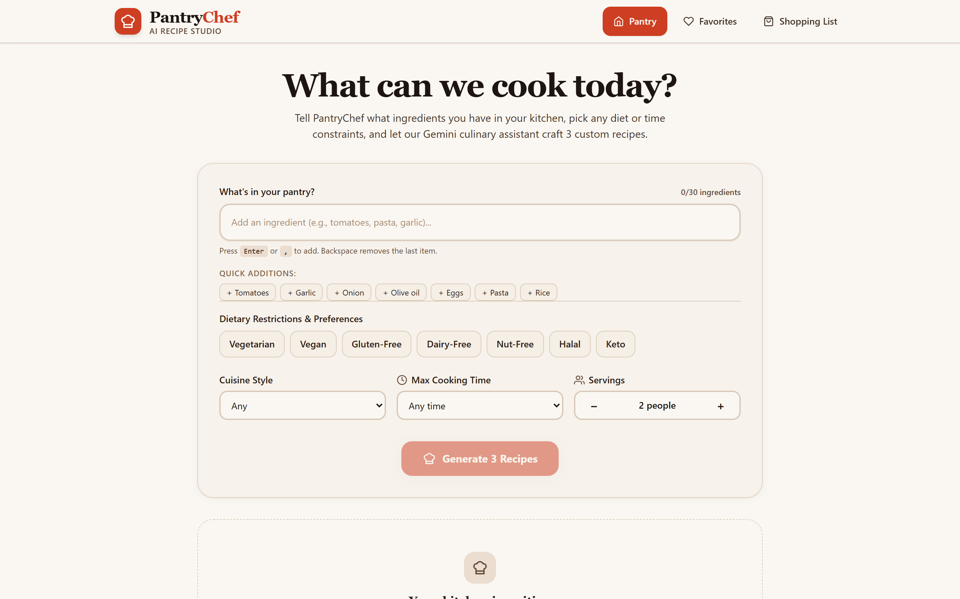
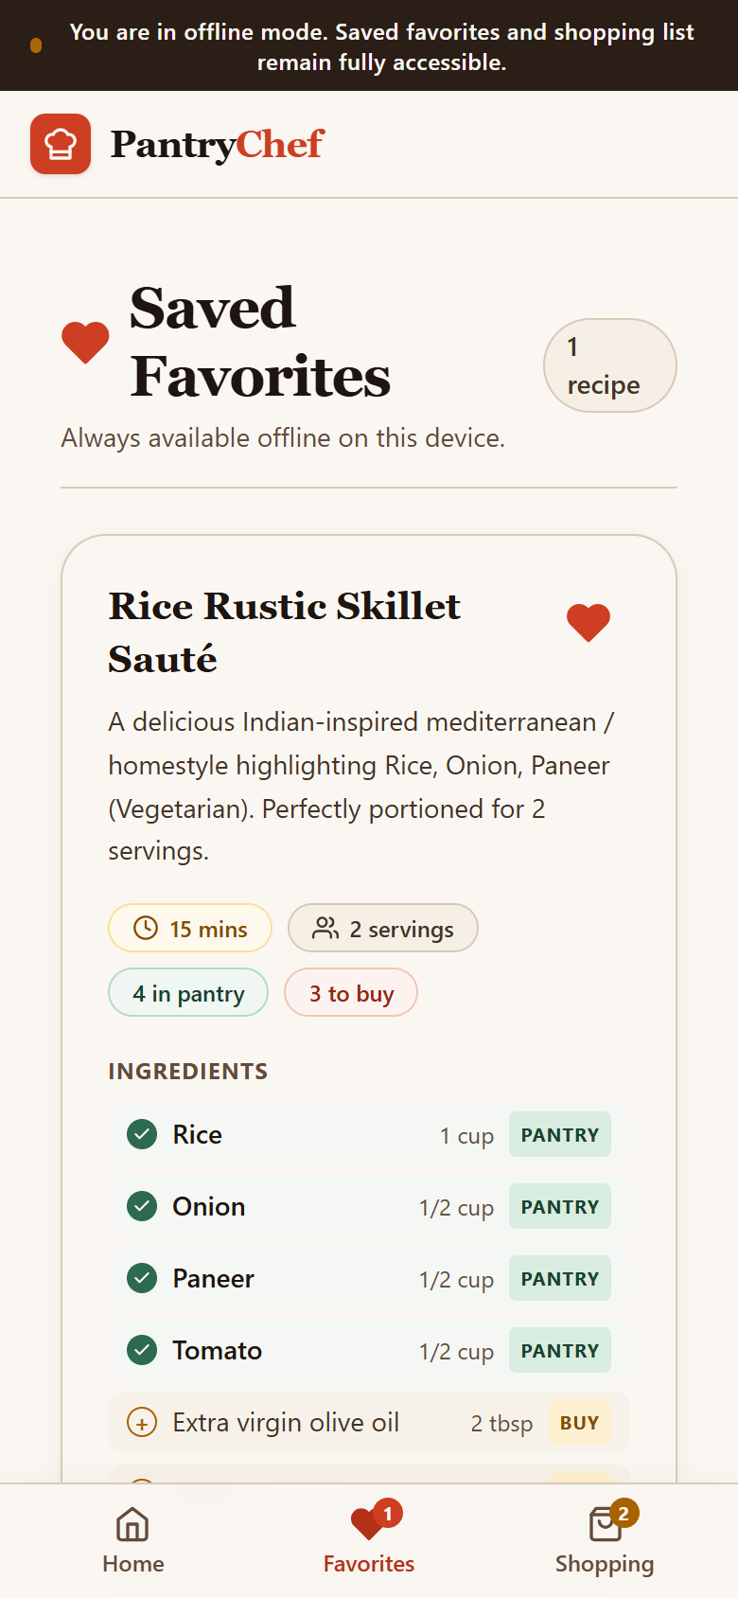
METHODOLOGY
UI/UX Design Tokens & PWA Architecture
Food-Inspired Identity, Mobile-First Ergonomics, and True Offline Resilience
DESIGN TOKENS & ACCESSIBILITY
• Food-Inspired Palette:
Paprika Red (#CE3E22), Saffron Gold (#C97A00), Basil Green (#2D6A4F), Warm Cream (#FAF7F2), Espresso (#1E1510).
• Typography & Contrast:
Georgia serif headers paired with clean Calibri sans body; WCAG AA contrast compliance across all text.
• Touch Ergonomics:
44px minimum tap target sizes on interactive chips, steppers, and navigation icons for greasy kitchen fingers.
• Offline-First Storage:
Favorites and shopping lists persist locally via IndexedDB with automatic localStorage fallback.
[Insert photo: phone-install.png
App icon on real phone screen]
Desktop home view
Physical phone install (placeholder)
[Insert photo: phone-standalone.png
App in standalone display mode]
Mobile home (emulated)
Offline favorites (emulated)
Physical standalone view (placeholder)

Slide 11
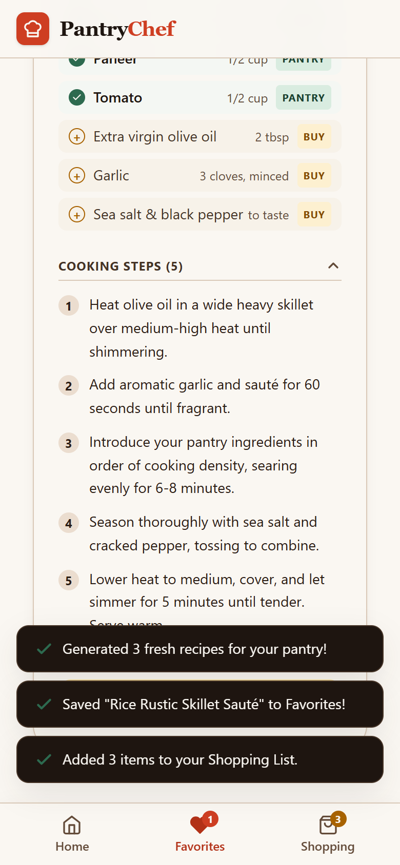
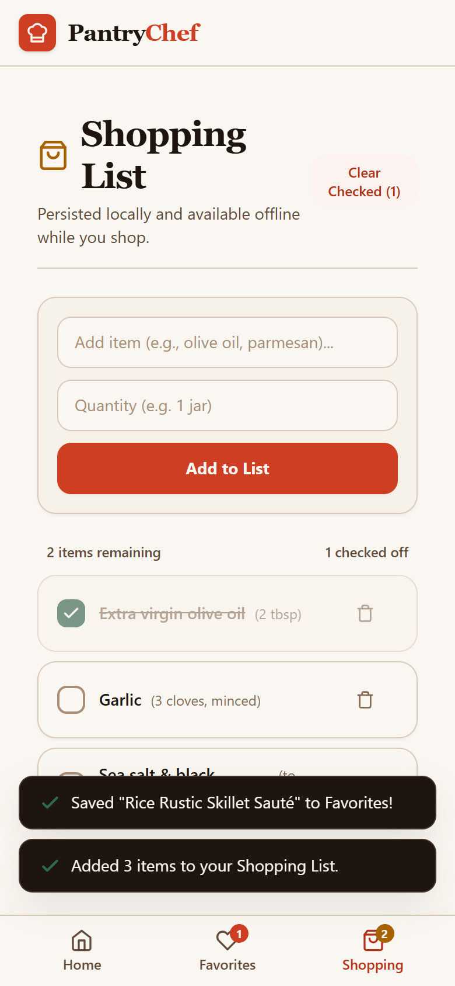
RESULTS
Working Application: 5-Step Storyboard
Verified Walkthrough from Empty Pantry to Generated Meals and Grocery Checklist
Step 1: Add Chips
Type ingredients (rice, onion, paneer); chips appear instantly.
Step 2: Set Filters
Select Vegetarian, 30 min limit, Indian cuisine & 2 servings.
Step 3: AI Generation
Receive 3 structured recipes: Paneer Bhurji, Fried Rice & Curry.
Step 4: Save Favorite
Save favorite dishes to local device storage with one tap.
Step 5: Grocery List
Add missing ingredients to shopping list with strike-through checks.

Slide 12
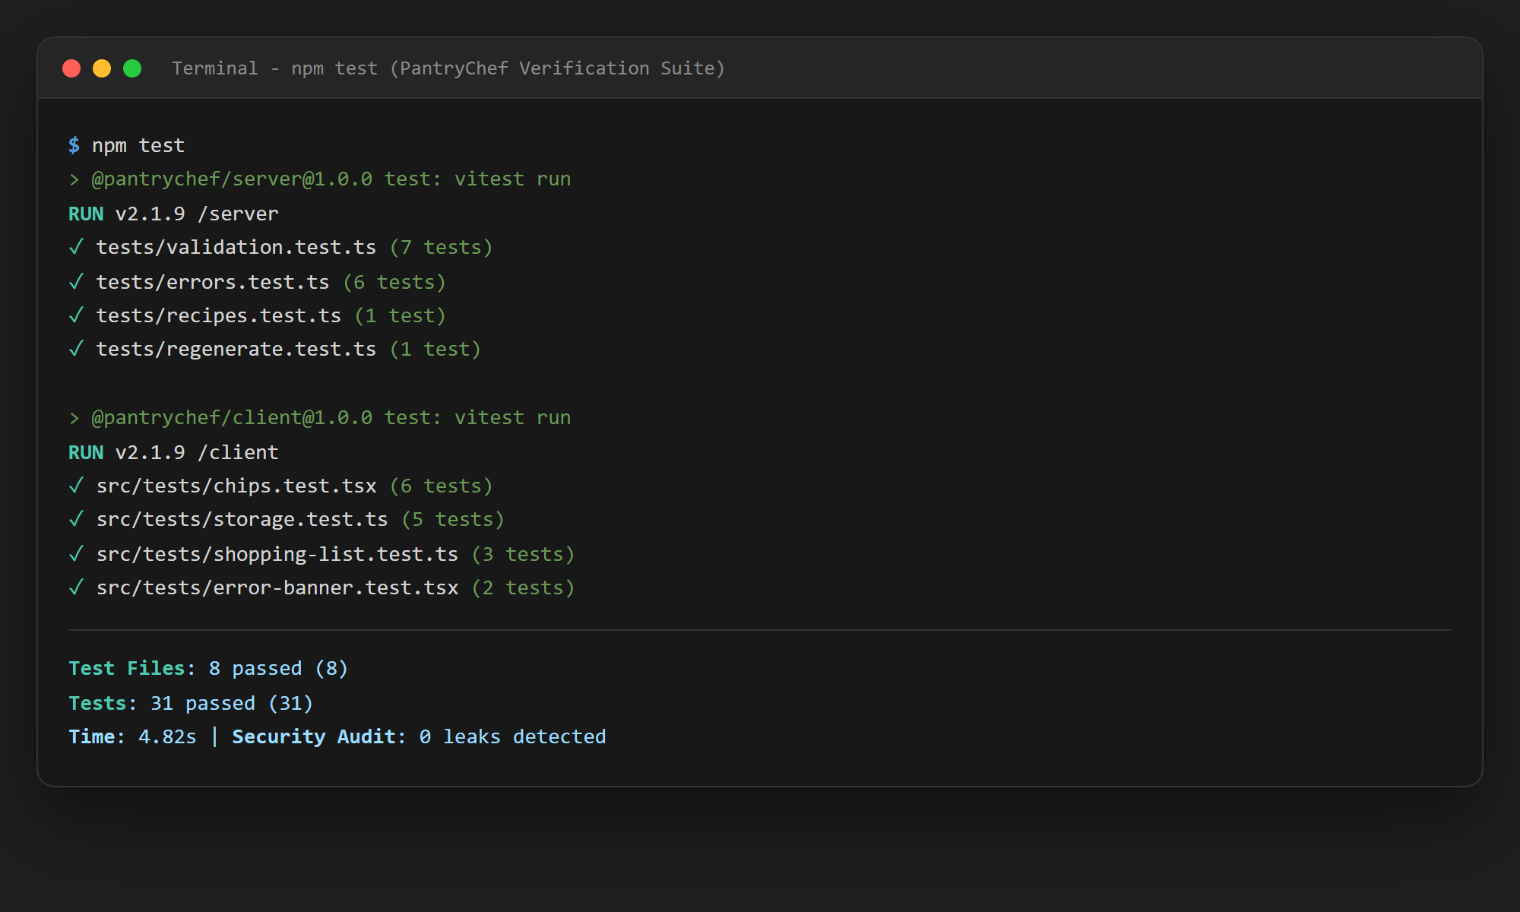
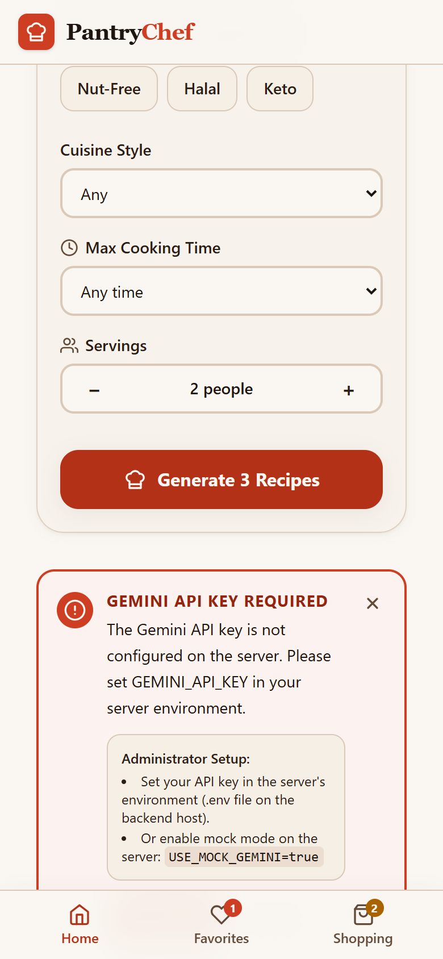
RESULTS
System Testing, Verification & Secrets Audit
Empirical Test Results, Key Security Scans, and AI Output Evaluation Framework
EMPIRICAL AUTOMATED TEST RESULTS
• Backend Test Suite (Vitest + Supertest)
Result: 15 / 15 PASSED (100%)
Scope: Payload bounds, Zod rejections, 10KB caps, 6-code error mapping, unique titles.
• Frontend Test Suite (Vitest + JSDOM)
Result: 16 / 16 PASSED (100%)
Scope: Chip entry/removal, keyboard events, storage corruption recovery, shopping deduplication.
• Security Secrets Audit (check-secrets.mjs)
Result: 99 FILES SCANNED • 0 LEAKS
Scope: Scanned all sources & client bundles; verified 0 AIza keys and 0 GEMINI_API_KEY tokens in client.
AI OUTPUT QUALITY & CONSTRAINT EVALUATION
[Insert evaluation: number of test inputs, and how many responses followed the diet, time and servings filters]
Note: Fill only if measured with live Gemini API key; never invent unverified evaluation metrics.
Terminal capture: Passing Vitest suites & 0-leak secret scan
Friendly 503 error handling (emulated)

Slide 13
CONCLUSION AND FUTURE WORK
Project Conclusion & Objective Evaluation
Verified Deliverables, Critical Limitations, and Applied AI Learnings
OBJECTIVE (SLIDE 4) | VERIFIED DELIVERABLE | STATUS
1. Dynamic Synthesis | Generates 3 distinct recipes respecting diets and time limit. | ACHIEVED
2. Server Key Isolation | Key stored in server .env; 0 client bundle leaks across 99 files. | ACHIEVED
3. Schema Enforcement | Dual Zod validation with automatic retry on malformed JSON. | ACHIEVED
4. Offline Persistence | Favorites & shopping list persist via IndexedDB without Wi-Fi. | ACHIEVED
5. PWA Installability | Service worker precaching, manifest, and home screen install flow. | ACHIEVED
HONEST TECHNICAL LIMITATIONS
• AI Accuracy & Hallucinations: LLMs may produce unconventional ingredient pairings or misjudge cooking times slightly.
• Critical Allergen Risk: Users must personally verify ingredients for severe peanut/gluten allergies before consumption.
• Network Dependency: While saved favorites are offline, generating new recipes strictly requires an active internet connection.
CORE ENGINEERING & AI LEARNINGS
• Prompt Injection Resilience: Passing user inputs as raw JSON arrays prevents prompt override attempts reliably.
• Schema-First AI Architecture: Enforcing response schemas converts unpredictable text models into robust UI APIs.
• Offline-First Web Synergy: Combining Service Workers with IndexedDB delivers native-app responsiveness on the web.

Slide 14
CONCLUSION AND FUTURE WORK
Future Research & Applied AI Roadmap
Extending PantryChef from Functional Prototype to Intelligent Culinary Ecosystem
Phase 1: Multimodal Vision OCR
Incorporate Gemini Vision to enable home cooks to snap a single photograph of their refrigerator shelves, automatically populating ingredient chips without manual typing.
Phase 2: Nutritional & Macro Analytics
Integrate verified USDA food composition APIs to compute precise caloric breakdowns, protein macros, and glycemic estimates for generated recipes.
Phase 3: Multi-Device Cloud Sync
Introduce optional end-to-end encrypted user accounts allowing family members to synchronize weekly meal plans and shopping checklists across devices.
Phase 4: Quantitative Evaluation Benchmark
Build an automated evaluation framework testing 1,000 pantry combinations against strict dietary constraints, measuring exact hallucination rates and safety compliance.

Slide 15
CONCLUSION AND FUTURE WORK
Thank You & Evaluator Q&A
Course: CSE279 Artificial Intelligence Project • PantryChef Capstone
Thank You for Your Time & Evaluation!
PantryChef is ready for live demonstration and faculty examination.
PROJECT TEAM MEMBERS
Deval Yadav • Amil Muhammad • Aakash • Rupesh Kumar
We are now open for faculty questions, architecture defense, and live software walkthrough.

